Slide 1
A Style-Based Generator Architecture for Generative Adversarial Networks
Jianghao Lin
Aug 13, 2019

Slide 2
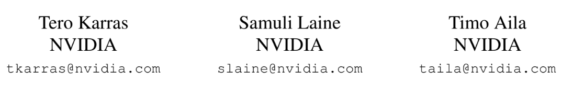
CVPR 2019
A Style-Based Generator Architecture for Generative Adversarial Networks

Slide 3
Content
Introduction
Motivation
Architecture Details
Evaluation and Result
Conclusion

Slide 4

What is GAN (Generative Adversarial Networks) ?
Usually a latent vector: [1.65, 0.68, 1.98, 0.25, 0.39, …, 0.87, 2.91, 1.87]

Slide 5
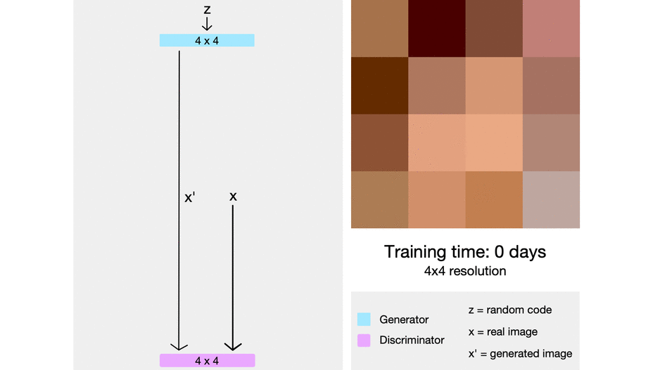
What is ProGAN (Progressive grow of GAN) ?

Slide 6
Content
Introduction
Motivation
Architecture Details
Evaluation and Result
Conclusion

Slide 7
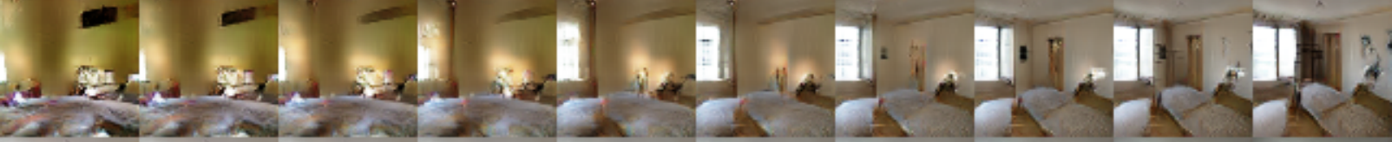
Latent Vector z: not just a random noise
Interpolation between latent vectors
Realistic generated images + Feature controlling ?

Slide 8
Problem to be solved: Feature Entanglement
Latent vector: [1.65, 0.68, 1.98, 0.25, 0.39, …, 0.87, 2.91, 1.87]
0.78
Change of hair color
Change of gender

Slide 9
Problem to be solved: Feature Entanglement
Latent vector: [1.65, 0.68, 1.98, 0.25, 0.39, …, 0.87, 2.91, 1.87]
0.77
0.78
Change of hair color
Change of gender

Slide 10
StyleGAN
High-resolution and realistic images (based on ProGAN)
Feature Disentanglement: superior control and understanding of the features of generated images

Slide 11
Content
Introduction
Motivation
Architecture Details
Evaluation and Result
Conclusion

Slide 12
No modification to discriminator
A Style-Based Generator Architecture for Generative Adversarial Networks

Slide 13
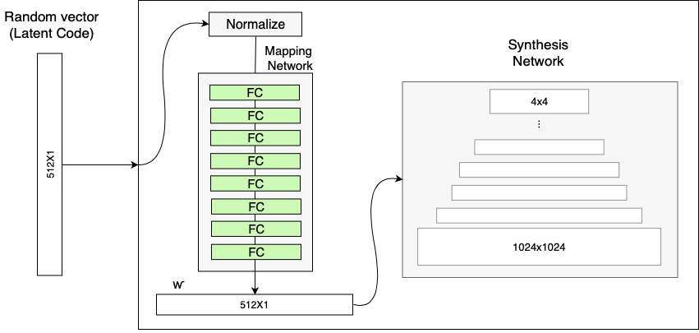
Mapping Network

Slide 14
Style Modules (AdaIN：Adaptive instance normalization）
When we want to paint a face with features:
[black hair, yellow skin, wearing glasses, smiling, woman, …, white teeth]

Slide 15
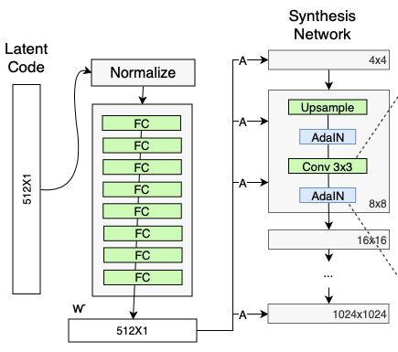
Style Modules (AdaIN：Adaptive instance normalization)

Slide 16
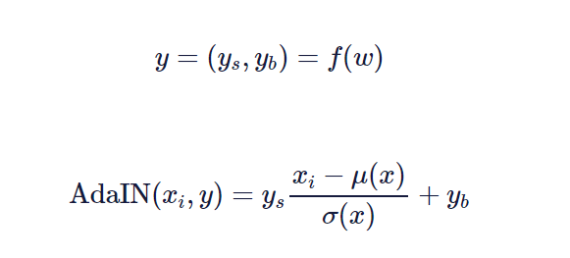
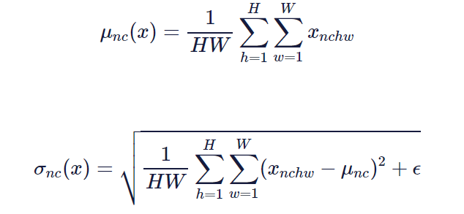
Style Modules (AdaIN：Adaptive instance normalization)

Slide 17
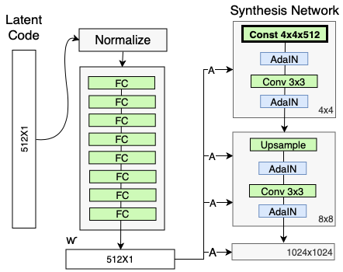
Constant Input of Generator
→ Skeleton of images
？？？

Slide 18
Stochastic variation
Variation term
512 x 1

Slide 19
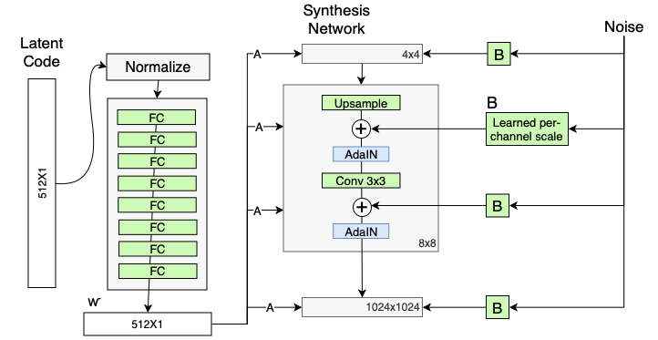
Stochastic variation

Slide 20
Style Mixing
Independently injected, independently handled.

Slide 21

Style Mixing
Latent code 1: [blue hair, smiling, no glasses]
Latent code 2: [black hair, grinning, round glasses]
Latent code 3: [pink hair, no-smile, sun glasses]

Slide 22
Content
Introduction
Motivation
Architecture Details
Evaluation and Result
Conclusion

Slide 23
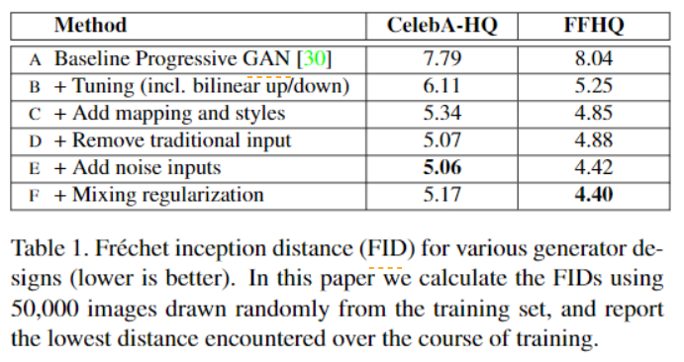
Evaluate image qualities: FID

Slide 24
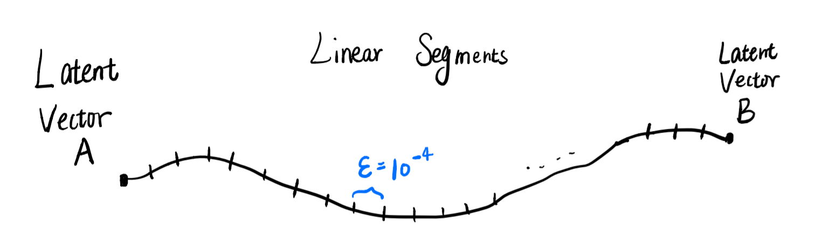
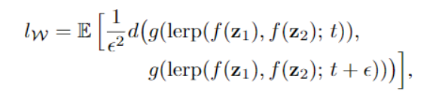
Evaluate Feature Disentanglement: (Average) Perceptual path length
Drastic changes mean that multiple features have changed together and that they might be entangled.

Slide 25
Evaluate Feature Disentanglement: (Average) Perceptual path length
Drastic changes mean that multiple features have changed together and that they might be entangled.

Slide 26
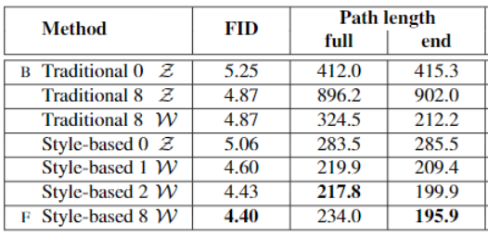
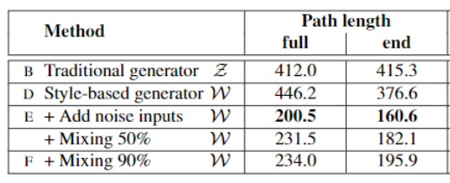
Evaluate Feature Disentanglement: (Average) Perceptual path length

Slide 27
Evaluate Feature Disentanglement: Linear separability
If a latent space is sufficiently disentangled, it should be possible to find direction vectors that consistently correspond to individual factors of variation.
We propose another metric that quantifies this effect by measuring how well the latent-space points can be separated into two distinct sets via a linear hyperplane (SVM), indicating the degree of disentanglement.

Slide 28
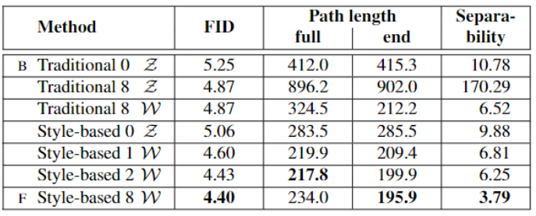
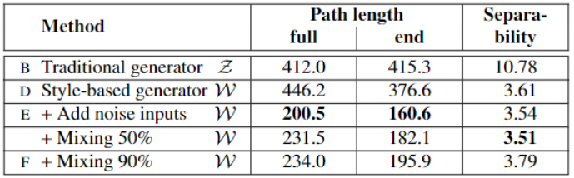
Evaluate Feature Disentanglement: Linear separability

Slide 29
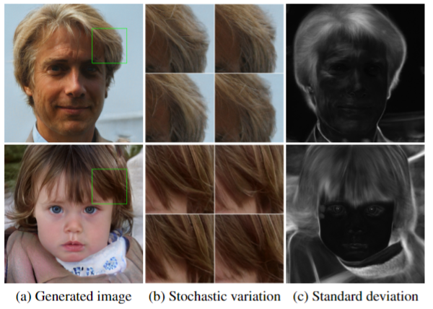
Stochastic variation

Slide 30
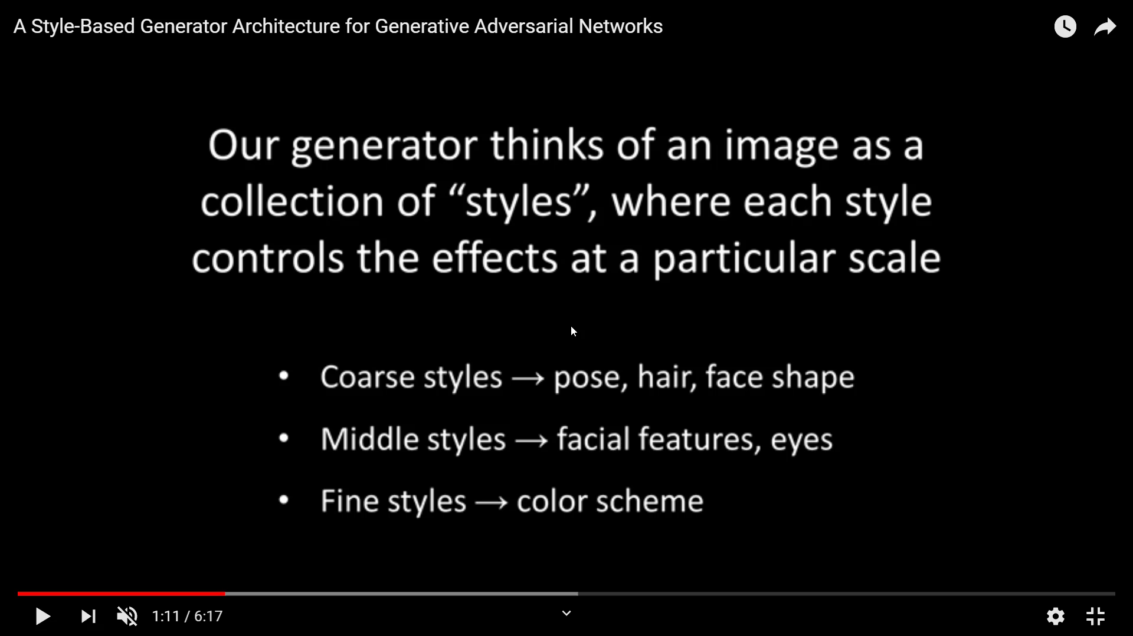
Style Mixing
Pose, hair, face shape →
Facial features, eyes →
Color scheme →

Slide 31
Content
Introduction
Motivation
Architecture Details
Evaluation and Result
Conclusion

Slide 32
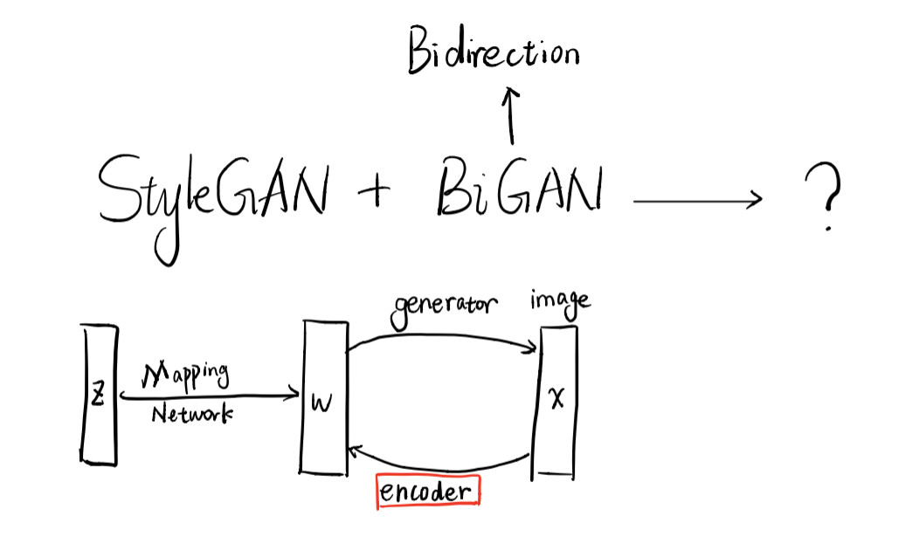
StyleGAN
Image quality (√)
Feature Disentanglement (√)

Slide 33
Q&A

